Slide 1

Are all countries as urbanised as each other?
TERM 1 Week 6
Year 8 Altior 2023

Slide 2

Watch
https://www.youtube.com/watch?v=fKnAJCSGSdk
Take notes in your book

Slide 3
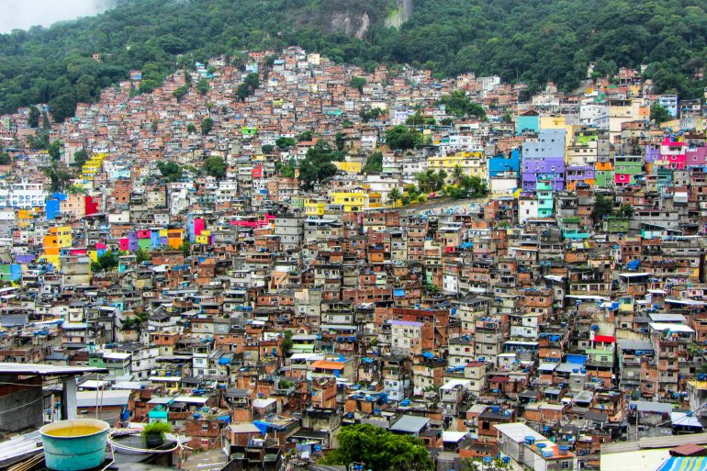
What would it be like living here?
Rio di Janeiro, Brazil

Slide 4
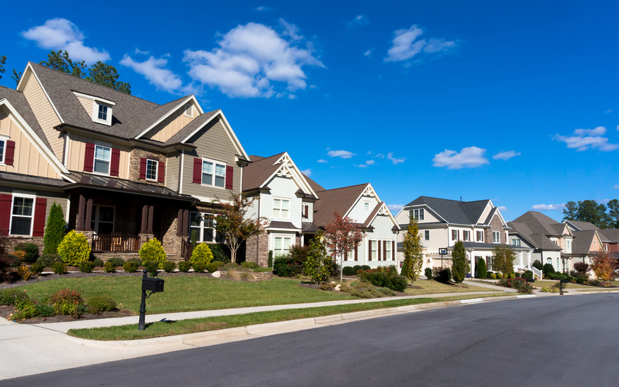
What would it be like living here?
Georgia, USA

Slide 5
If you don’t live in an urban area (city), where do you live?

Slide 6
If you don’t live in an urban area (city), where do you live? In a rural area (the country)

Slide 7
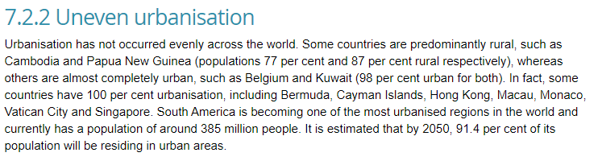
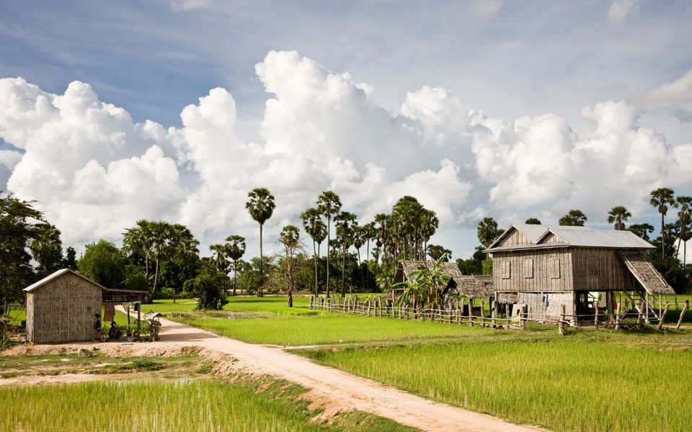
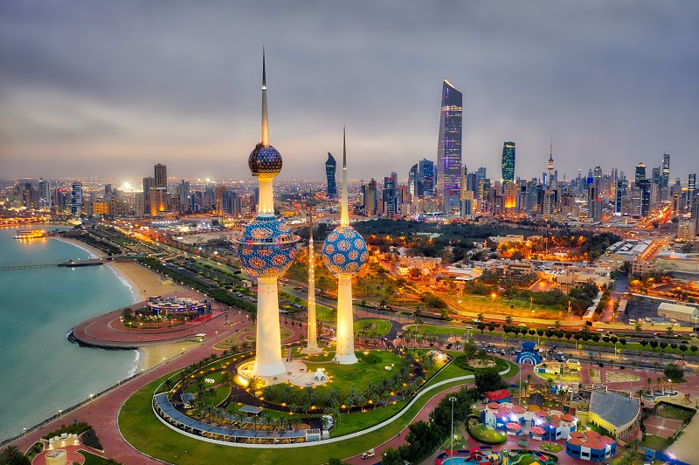

Slide 8
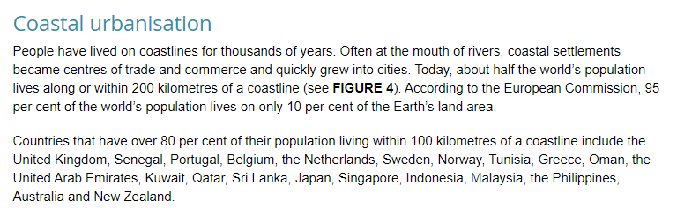

Slide 9

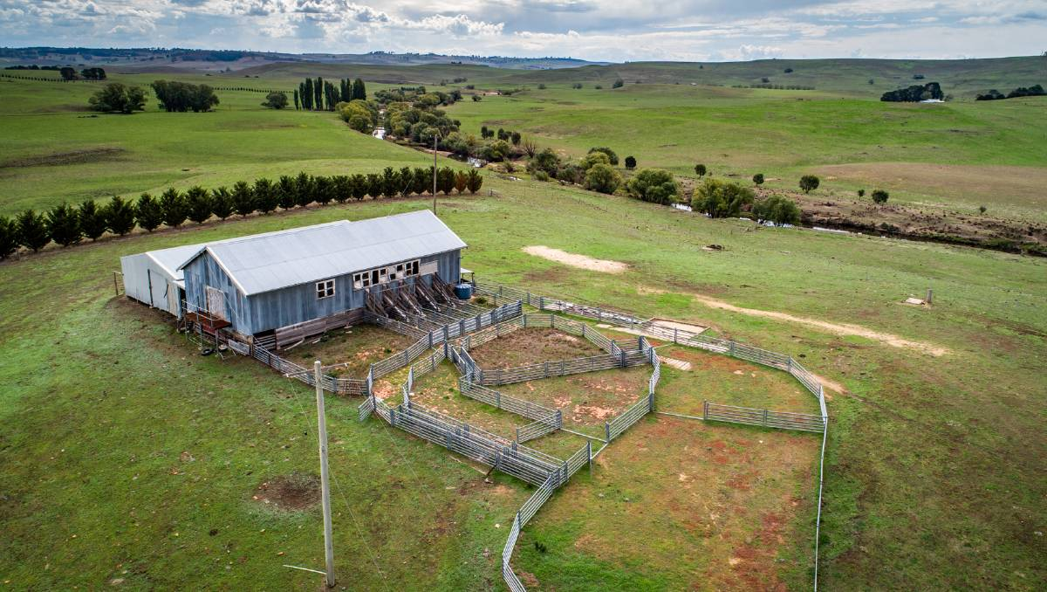
Urban Living Vs Rural Living
https://www.youtube.com/watch?v=n-4hL_4IBsM

Slide 10
Urban Living Rural Living
Positives | Negatives
Positives | Negatives

Slide 11
Tasks
Answer the questions in your exercise book. Use the images above and chapter 7.2 to help you.
Define urbanisation in your own words.
Explain how FIGURE 1 (slide 18) shows that urbanisation has varied in different regions of the world. Which two regions have the greatest rural population?
Look at FIGURE 1(slide 18). Which region's urbanisation rate has consistently been the highest over time? Why do you think that is?
Would you prefer to live in an urban or rural area? Explain your reasons.

Slide 12
What did we learn last lesson? Nothing

Slide 13
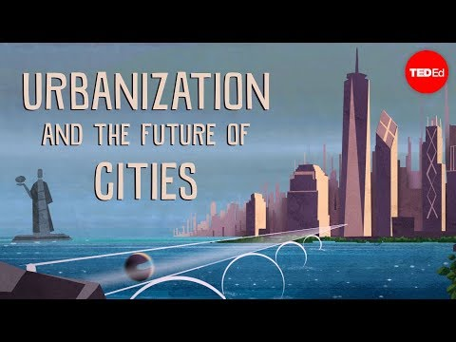

Slide 14

So why do we insist on living so close together??

Slide 15
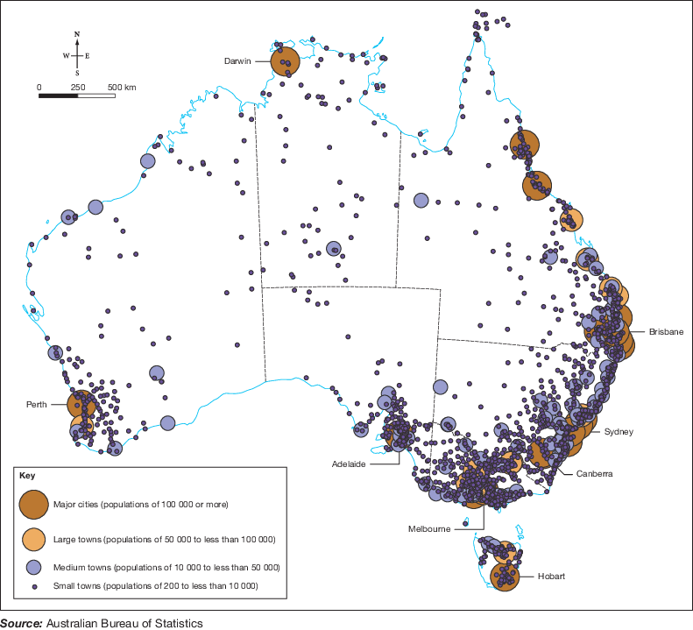
Where do most Australians live?

Slide 16
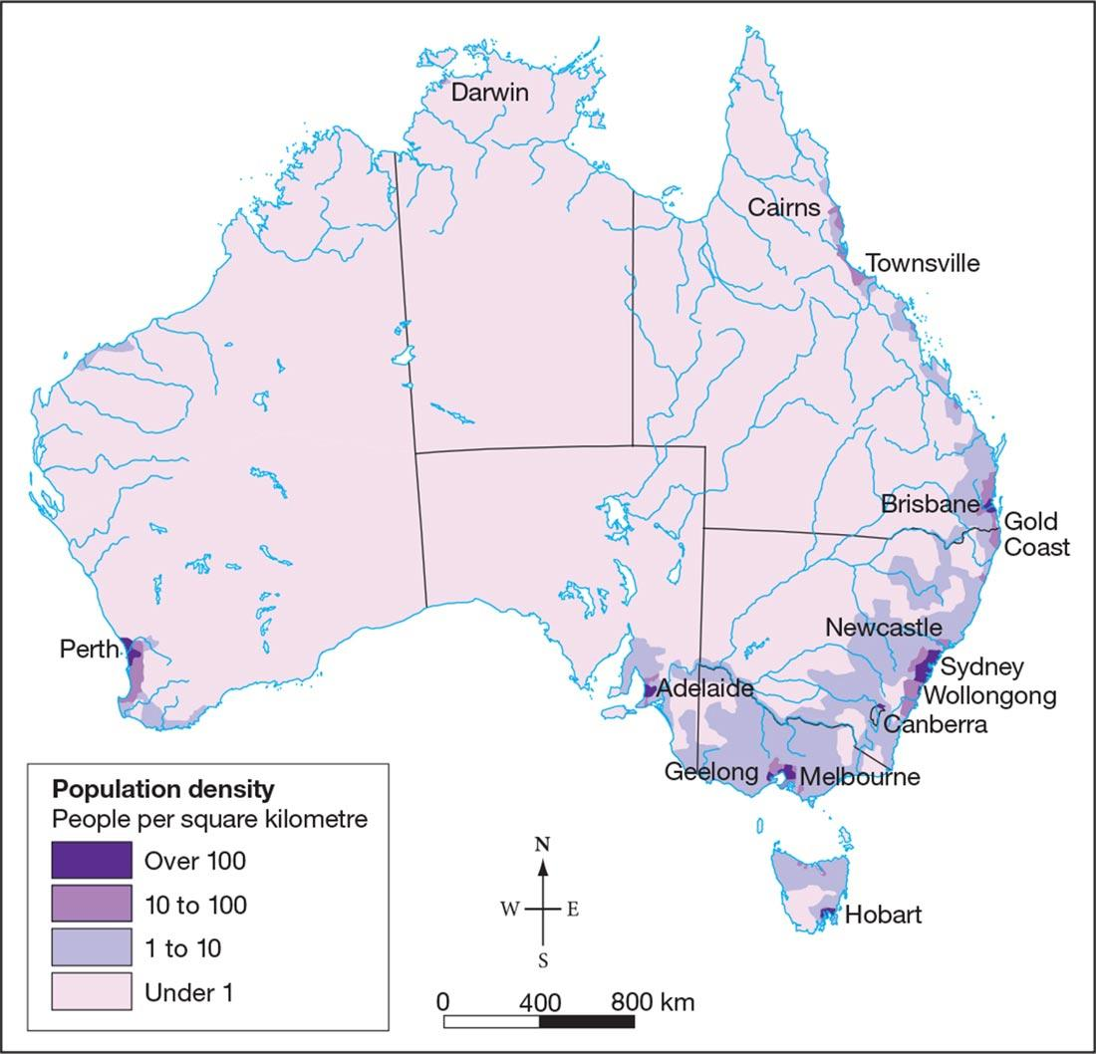
Most Australians live near the coast.
Why do you think that is?
Over 80% of Australians live in towns that have more than 1000 residents and are located within 50km of the coast.
Notes:
We may think of ourselves as an outback-loving, farming nation, but we mostly live near the coast.
Most Australians currently live within a narrow coastal strip which extends from Brisbane in the north to Adelaide in the south. Over 80 per cent of Australians live in towns that have more than 1000 residents and are located within 50 kilometres of the coast. Australians love the beach, but is it just a coastal location that can explain this uneven population distribution pattern?

Slide 17
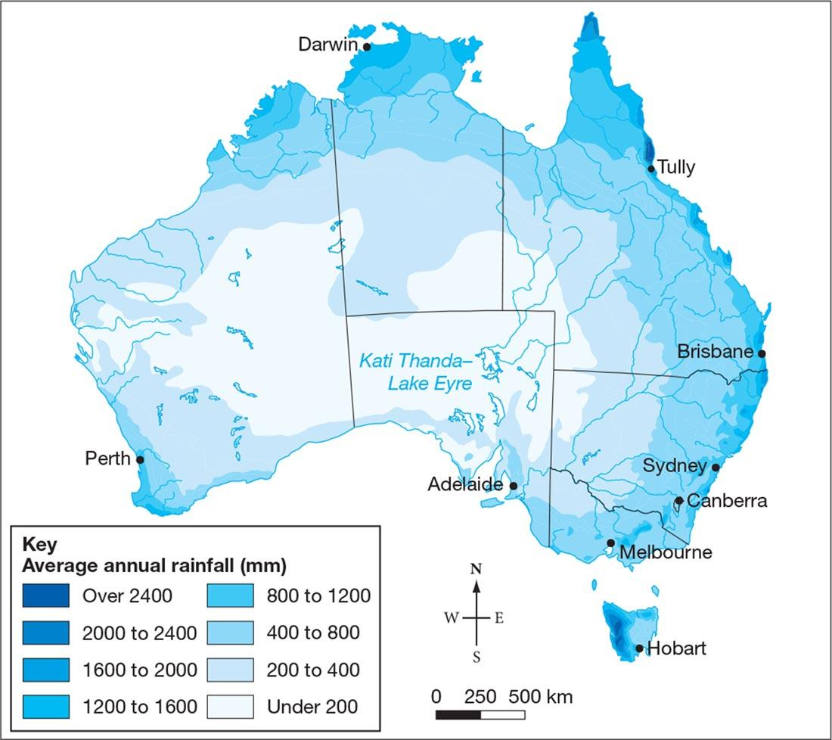
This map shows Australia’s annual rainfall.
What connections can you make between the amount of rain, where it falls and where people live?

Slide 18
Where do Australians live?
Coast locations and rainfall are not the only reason why Australians live where they do. We also consider:
Availability of mineral resources
Irrigation schemes to help farm production
Remote scenery
Tourist destinations
These are geographical factors that draw people to live in a particular place
Write this in your exercise book

Slide 19
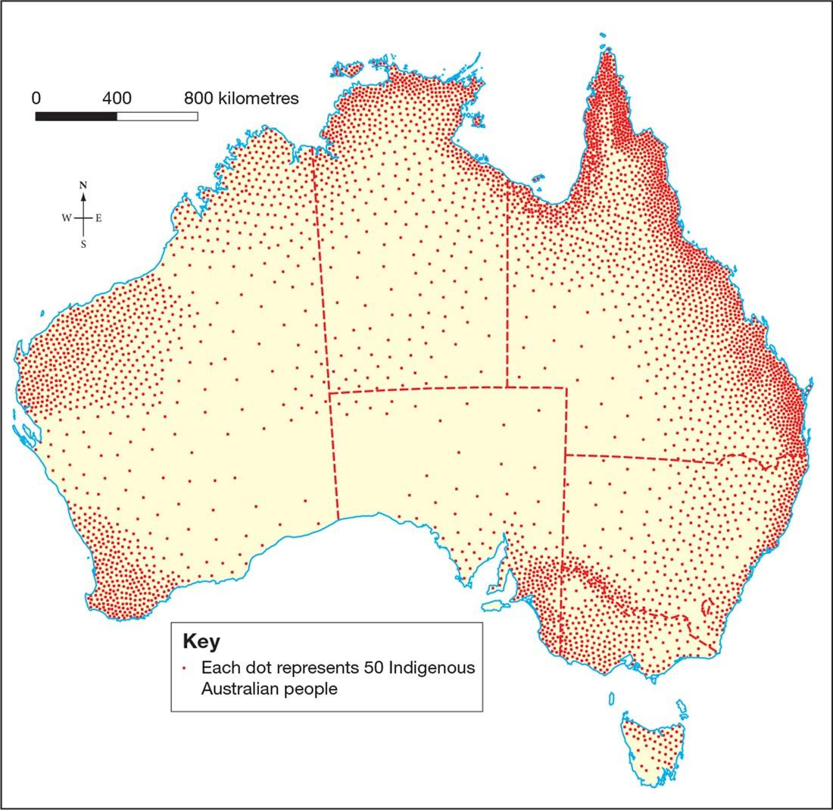
This map shows where the Indigenous Australians lived in 1788.
One dot represents about 50 Indigenous Australians.
The population density was highest close to coastal and river environments.
Why do you think that is?
Notes:
The population density of Aboriginal and Torres Strait Islander peoples was highest in places close to coastal and river environments.
These places had the best availability of food and other resources.
In a location such as Port Jackson, New South Wales, food was abundant, meaning that the inhabitants needed to spend only about four hours each day hunting or gathering enough for their survival.
In places where rainfall was unreliable, such as central Australia, the local peoples found it harder to survive.
They often needed more than half a day to hunt and gather enough to satisfy their basic needs. When food resources ran low or with changing seasons, communities moved on to another part of their country.
Being nomadic, they could manage their environment by not over-using the resources available at any one site.

Slide 20
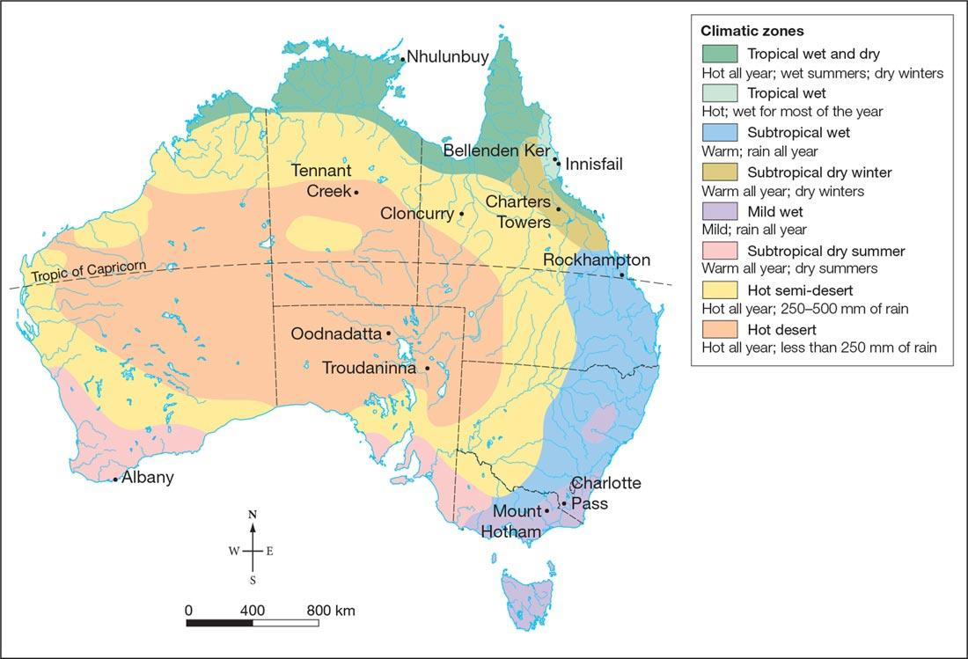
Australia’s climate is generally very pleasant and mild.
Most of the country receives more than 3000 hours of sunshine a year!
Notes:
nshine a year!try receives more than 3000 hours of sunshine a year!

Slide 21
Task 1:
1. Choose one of the following places in Australia
Oodnadatta, South Australia
Marble Bar, Western Australia
Liawenee, Tasmania
Bellenden Ker, North Queensland
2. Find out what makes this place unique in relation to their climate
Coldest place?
Hottest place?
Longest dry spell?
Most rain?
3. Come up with a list of three reasons why someone would want to live in this area
Task 2: Use chapter 7.3 to help you.
Use the maps on the slides to describe where most people in Australia live.
What geographical factors other than rainfall may lead to the uneven distribution of population in Australia?
What percentage of Australians live in urban areas? Of these, what percentage live in urban areas close to the coast?

